Slide 1
LCD Interfacing with ARDUINO
Dr. G. V. Prasanna Anjaneyulu

Slide 2
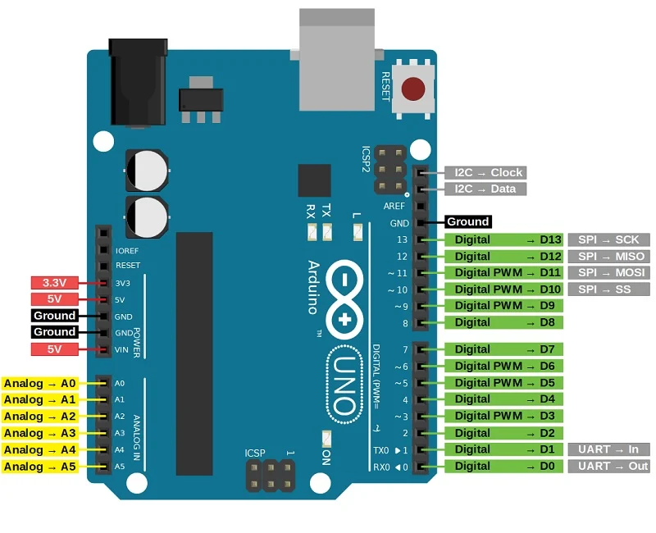
Dr. G. V. Prasanna Anjaneyulu

Slide 3
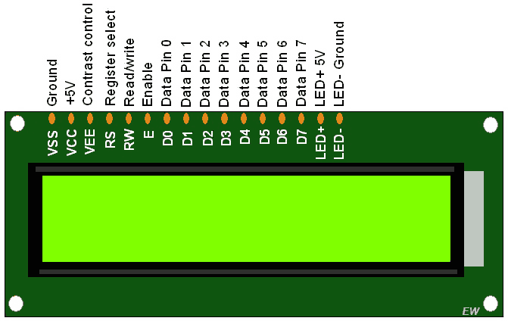
Dr. G. V. Prasanna Anjaneyulu
16 x 2 LCD DISPLAY

Slide 4

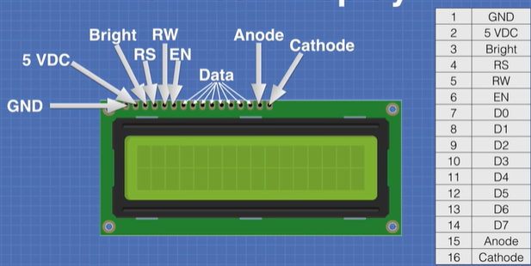
Dr. G. V. Prasanna Anjaneyulu

Slide 5
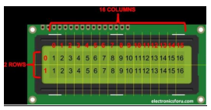
Dr. G. V. Prasanna Anjaneyulu

Slide 6
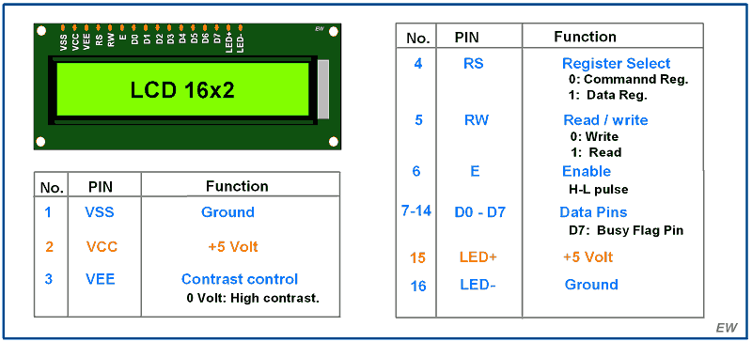
Dr. G. V. Prasanna Anjaneyulu

Slide 7
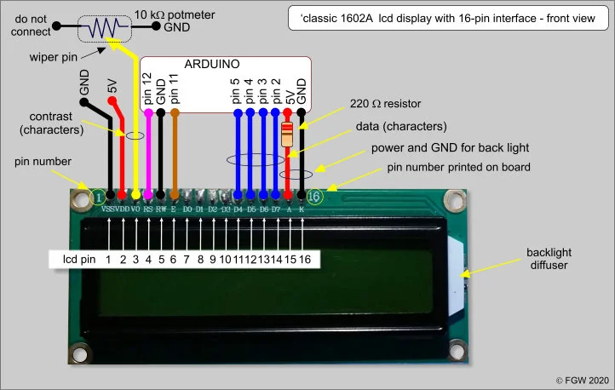
Dr. G. V. Prasanna Anjaneyulu

Slide 8
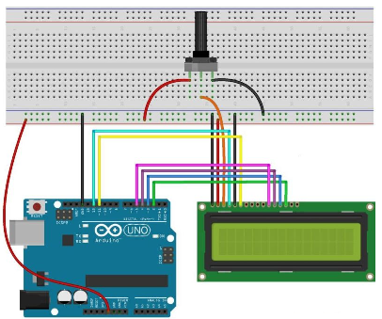
Dr. G. V. Prasanna Anjaneyulu

Slide 9
Dr. G. V. Prasanna Anjaneyulu

Slide 10
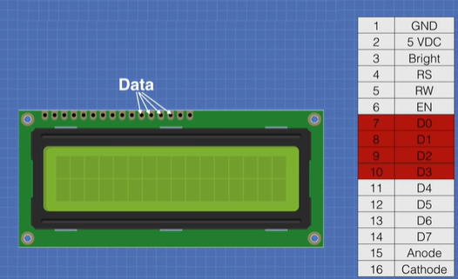
For Half-Byte data transfer D4,D5,D6,D7 pins are used (D0,D1,D2,D3 are not used)
Dr. G. V. Prasanna Anjaneyulu

Slide 11
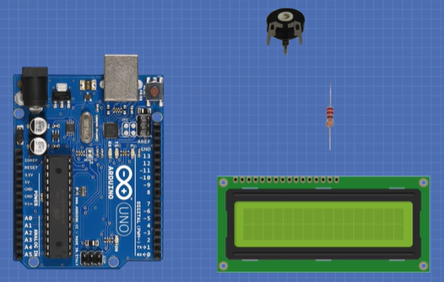
Components
Dr. G. V. Prasanna Anjaneyulu

Slide 12
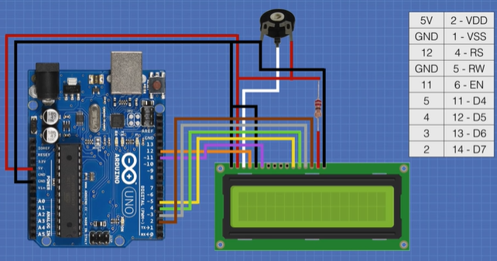
Dr. G. V. Prasanna Anjaneyulu

Slide 13
Dr. G. V. Prasanna Anjaneyulu

Slide 14
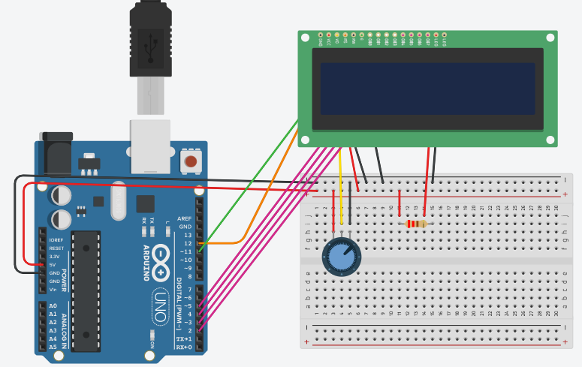
Implementation
Dr. G. V. Prasanna Anjaneyulu

Slide 15
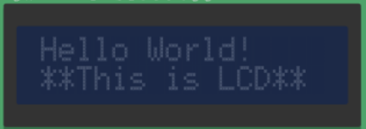
Q) WAP to print Hello World! In 1st row and **This is LCD** in 2nd row from 0th column
Dr. G. V. Prasanna Anjaneyulu

Slide 16
LiquidCrystal lcd(12,11,5,4,3,2);
Dr. G. V. Prasanna Anjaneyulu
Data pins
Enable LCD
Register Select

Slide 17
Program
//LCD Interfacing with ARDUINO
#include<LiquidCrystal.h>
LiquidCrystal lcd(12,11,5,4,3,2); //RS,E,5,4,3,2
void setup()
{
lcd.clear();
lcd.begin(16,2);
lcd.setCursor(0,0);
lcd.print("Hello World!");
lcd.setCursor(0,1);
lcd.print("**This is LCD**");
}
void loop()
{
}
Dr. G. V. Prasanna Anjaneyulu

Slide 18
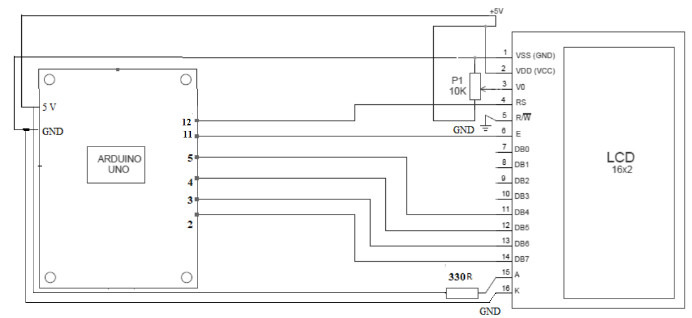
Circuit Diagram
Dr. G. V. Prasanna Anjaneyulu

Slide 19
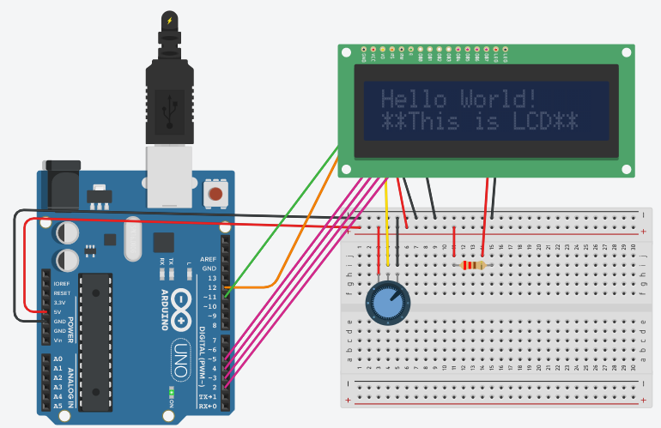
Result
Dr. G. V. Prasanna Anjaneyulu

Slide 20
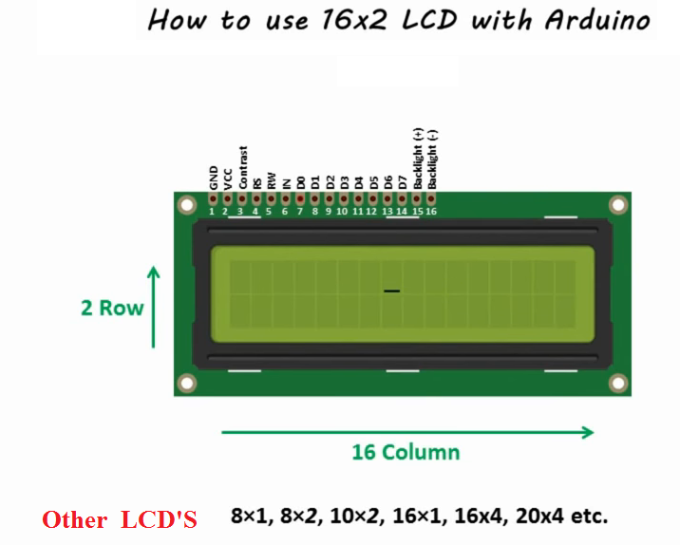
Dr. G. V. Prasanna Anjaneyulu

